Slide 1
DEALING WITH STATISTICAL QUERIES Cheryl Voake-Jones C.Voake-Jones@bath.ac.uk

Slide 2
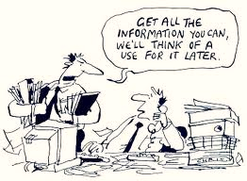
Advice for students
Do
bring a copy of your data/computer
seek advice at the planning stage
be prepared to do your own research
Don’t
put off statistical analysis until the end of your project
expect a quick fix

Slide 3
Advice for tutors
You are an adviser, not a replacement lecturer
Remind them that you are not an expert in biology / sports science / economics / social science / psychology / ….
Advisory vs consultancy
Make sure the student does some exploratory data analysis

Slide 4
Do you know your data?
Student: “I want to see if there is a difference in spending habits in the campus cafés between undergraduates and postgraduates.”
Tutor: “How many do you have in each group?”
Student: “Errr…ummm…”

Slide 5
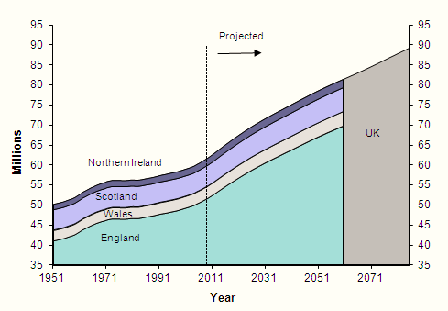
Do you need statistics?
If your results speak for themselves, don’t interrupt them!

Slide 6
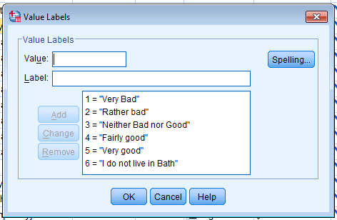
Validation
Do not take the data at face value
How do you rate Bath as a place to live?

Slide 7
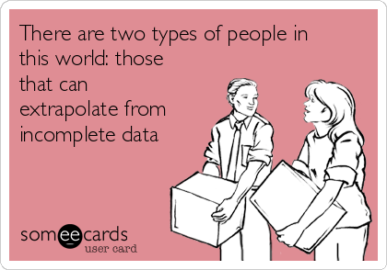
Missing values
Handling missing values
How to handle them?
Can they be inferred?
If there are none, why not?

Slide 8
Sampling bias
Do you like to answer questionnaires?
□ Yes □ No

Slide 9
Confounding
35%
44%

Slide 10
Confounding
Sex bias in graduate admissions: Data from Berkeley
P. J. Bickel, E. A. Hammel, J. W. O'Connell
Science, New Series, Vol. 187, No. 4175 (Feb. 7, 1975), pp. 398-404

Slide 11
Statistical analysis can be subjective

Slide 12
Software

Slide 13
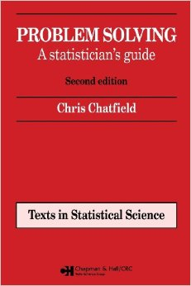
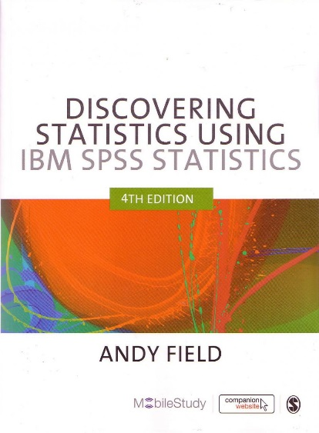
Resources
statstutor website: www.statstutor.ac.uk
Statistics glossary: www.stats.gla.ac.uk/steps/glossary/
Statistics notes: www.statslab.cam.ac.uk/~pat/

